Slide 1
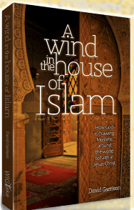
A Wind in the
House of Islam
Bridges and Barriers
to Muslim Movements
to Christ
From the new book by David Garrison.
© 2013 WIGTake Resources
www.WindintheHouse.org
Notes:
The contents of this PowerPoint presentation are adapted from the book by Dr. David Garrison, A Wind in the House of Islam (Monument, CO: WIGTake Resources, 2014), 328 pp. ©WIGTake Resources. The book is available for purchase from the website: www.WindintheHouse.org.
This PowerPoint is a gift to the community of Christ and may be used freely so long as attribution is given to the book A Wind in the House of Islam.
Requests for modification of the PowerPoint should be directed to: Nora Hutchins of WIGTake Resources at NoHutch@wigtake.org.
This PowerPoint along with the notes is produced by David Garrison. Maps are produced by Jim Courson of the Global Research Department of the International Mission Board, SBC.

Slide 2
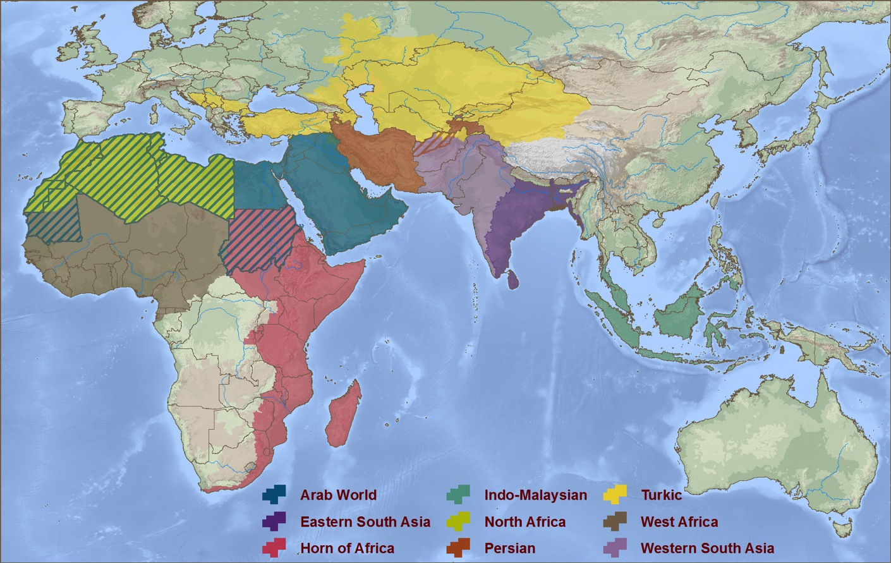
Nine Rooms in the House of Islam
Turkestan
Persian
World
Western
South Asia
North Africa
Arab World
Eastern
South Asia
West Africa
East Africa
Indo-Malaysia
© 2013 WIGTake Resources
www.WindintheHouse.org
Notes:
The House of Islam, or Dar al-Islam in Arabic, can be divided into nine geo-cultural zones or “Rooms” in the House of Islam. There are Muslim movements to Christ in each of the Nine Rooms.

Slide 3
Muslim Movements to Christ through the Centuries
Notes:
A retrospective look at nearly 14 centuries of Muslim-Christian interaction tells the story. Over these same centuries, tens of millions of Christians were converted to Islam and assimilated into the House of Islam. Yet in the first millennium of Muslim-Christian interchange, we could find only three possible movements of at least 1,000 Muslims from an Islamic community being baptized into any expression of the Christian faith.
The first hint of a shift in direction occurs in the latter decades of the 19th century, followed by a further 11 movements in the final third of the 20th century. However, in just the first 13 years of the 21st century, we have already seen an additional 69 Muslim movements to Christ.
We are indeed living in the midst of the greatest turning of Muslims to Christ in history.

Slide 4
A Fresh Look at the Muslim World
© 2013 WIGTake Resources
www.WindintheHouse.org
Notes:
More than two and a half thousand years ago, speaking through the prophet Habakkuk, God instructed His people to look to the nations, literally the goy, or people groups, of the world, among whom He said he would do something amazing, so amazing, in fact, that they would not believe it, even if they were told.
Many of God’s people see this prophecy as occurring today. God is doing something amazing among the nations of the earth, something that challenges our ability to grasp.

Slide 5
The First Global Survey
Quarter-million miles (25萬英里)
44 “Movements” surveyed
More than 1,000 interviews
Core Question: What did God use to bring you to faith in Jesus Christ? Tell me your story.

Slide 6
Barriers to Movements
1. Contentious (愛爭論的) Christians
2. Fear and Hatred
3. Imitating (模仿) Islam
4. Social Injustice
5. Ignorance and Apathy (無知和冷淡)
© 2013 WIGTake Resources
www.WindintheHouse.org
Notes:
For further explanation of each Barrier, see A Wind in the House of Islam (Monument, CO: WIGTake Resources, 2014).

Slide 7
Ten Bridges of God
Faith
Prayer
Scripture
Holy Spirit Activity
Faithful Witness
Learning from the Body of Christ
Effective Communication
Discovery
Indigenization
(本土化)
Islam Itself
© 2013 WIGTake Resources
www.WindintheHouse.org
Notes:
A Wind in the House of Islam is the result of more than a thousand interviews from Muslim-background believers, each one a part of the movements that are taking place from West Africa to Indo-Malaysia. Listening to these stories have allowed us to identify bridges that God is using to draw Muslims to Christ throughout the House of Islam.
Here are 10 bridges that God is using to foster movements of Muslims to Christ today:
1. Faith – believing that God desires Muslims’ salvation, and acting on that belief.
2. Prayer – the invisible force that tears down strongholds and unleashes the power of God.
3. Scripture – only as the word of God is translated into the heart languages of Muslims are they able to hear and respond to the gospel. Much remains to be done!
4. Holy Spirit – dreams, visions, conviction of lostness, answered prayers. Could it be that the Spirit has been at work for centuries, but we’re just now around to hear about it?
5. Faithful witness – Missionaries, historic Christian communities, giants who preceded us have been attested to in many testimonies of today’s Muslim-background movements.
6. Learning from the Body of Christ – as breakthroughs take place, effective patterns of witness are being shared. Many movements today trace to lessons first learned by others.
7. Effective communication – contextualized gospel witness is allowing Muslims to hear and understand the gospel’s message and its implications for them.
8. Discovery – As Muslims discover for themselves who Jesus is, they are drawn to Him.
9. Islam itself – Islam contains the seeds of its own destruction.
10. Indigenization – These movements are not foreign controlled. They are intensely owned by the Muslim-background believers who continue to pay a price for their faith in Christ.

Slide 8

Learn more…
© 2013 WIGTake Resources
www.WindintheHouse.org
Notes:
Don’t satisfy yourself to be a spectator in the greatest turning of Muslims to Christ in history. Sadly, most Christians only see Muslims as a threat, as the enemy of God’s Kingdom. They don’t realize that God loves Muslims too, and wants to see their salvation.
Learn more about God’s amazing work in the Muslim world, read about the stories of thousands of Muslims who are saying yes to Christ and finding forgiveness, salvation and new life in Him. Spread the word: there is a Wind blowing through the House of Islam!

