Slide 1
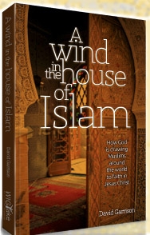
Lessons from A Wind in the House of Islam
The Challenge of Contextualization in Muslim Missions
From the new book by David Garrison.
© 2013 WIGTake Resources
www.WindintheHouse.org
Notes:
The contents of this PowerPoint presentation are adapted from the book by Dr. David Garrison, A Wind in the House of Islam (Monument, CO: WIGTake Resources, 2014), 328 pp. ©WIGTake Resources. The book is available for purchase from the website: www.WindintheHouse.org.
This PowerPoint is a gift to the community of Christ and may be used freely so long as attribution is given to the book A Wind in the House of Islam.
Requests for modification of the PowerPoint should be directed to: Nora Hutchins of WIGTake Resources at NoHutch@wigtake.org.
This PowerPoint along with the notes is produced by David Garrison. Maps are produced by Jim Courson of the Global Research Department of the International Mission Board, SBC.

Slide 2
For Fourteen Centuries Islam Has Expanded
Tens of millions of Christians assimilated into (被同化) Islam
© 2013 WIGTake Resources
www.WindintheHouse.org
Notes:
Looking back, the growth of Islam, from a tiny desert community in Mecca in the 7th century to the second largest religion in the world today, has been remarkable. Over the course of these nearly 14 centuries, Islam has gained adherents in every continent and nearly every country on earth. Along the way, tens of millions of people groups with ancient Christian roots have been assimilated into the House of Islam.

Slide 3
But What About the Opposite?
Have there ever been Muslim movements to Christ?
If so, where, when and how?
© 2013 WIGTake Resources
www.WindintheHouse.org
Notes:
Surely in the course of these nearly 14 centuries there have also been movements in the other direction. We know that individual men, women, and children have converted from Islam to Christianity, but have these ever occurred in significant numbers?
If we define a movement of Muslims to Christ as 1,000 baptisms or 100 new church starts over the course of one to two decades, can we find historic examples of Muslim movements to Christ? If so, where, when, and how did they occur?
Let’s review Muslim-Christian history now with an eye for Muslim movements to Christ.

Slide 4
Muslim Movements to Christ through the Centuries
Notes:
A retrospective look at nearly 14 centuries of Muslim-Christian interaction tells the story. Over these same centuries, tens of millions of Christians were converted to Islam and assimilated into the House of Islam. Yet in the first millennium of Muslim-Christian interchange, we could find only three possible movements of at least 1,000 Muslims from an Islamic community being baptized into any expression of the Christian faith.
The first hint of a shift in direction occurs in the latter decades of the 19th century, followed by a further 11 movements in the final third of the 20th century. However, in just the first 13 years of the 21st century, we have already seen an additional 69 Muslim movements to Christ.
We are indeed living in the midst of the greatest turning of Muslims to Christ in history.

Slide 5
We Know How Not to Win Muslims to Christ
IYKDWYBDYWKGWYBG
If you keep doing what you’ve been doing, you’ll keep getting what you’ve been getting!
© 2013 WIGTake Resources
www.WindintheHouse.org
Notes:
More than two and a half thousand years ago, speaking through the prophet Habakkuk, God instructed His people to look to the nations, literally the goy, or people groups, of the world, among whom He said he would do something amazing, so amazing, in fact, that they would not believe it, even if they were told.
Many of God’s people see this prophecy as occurring today. God is doing something amazing among the nations of the earth, something that challenges our ability to grasp.

Slide 6
How is God at Work?
© 2013 WIGTake Resources
www.WindintheHouse.org
Notes:
Looking back, the growth of Islam, from a tiny desert community in Mecca in the 7th century to the second largest religion in the world today, has been remarkable. Over the course of these nearly 14 centuries, Islam has gained adherents in every continent and nearly every country on earth. Along the way, tens of millions of people groups with ancient Christian roots have been assimilated into the House of Islam.

Slide 7
The First Global Survey
Quarter-million miles (25萬英里)
44 “Movements” surveyed
More than 1,000 interviews
Core Question: What did God use to bring you to faith in Jesus Christ? Tell me your story.

Slide 8
Ten Lessons Learned
It’s harvest time in the Muslim world.
© 2013 WIGTake Resources
www.WindintheHouse.org
Notes:
A Wind in the House of Islam is the result of more than a thousand interviews from Muslim-background believers, each one a part of the movements that are taking place from West Africa to Indo-Malaysia. Listening to these stories have allowed us to identify bridges that God is using to draw Muslims to Christ throughout the House of Islam.
Here are 10 bridges that God is using to foster movements of Muslims to Christ today:
1. Faith – believing that God desires Muslims’ salvation, and acting on that belief.
2. Prayer – the invisible force that tears down strongholds and unleashes the power of God.
3. Scripture – only as the word of God is translated into the heart languages of Muslims are they able to hear and respond to the gospel. Much remains to be done!
4. Holy Spirit – dreams, visions, conviction of lostness, answered prayers. Could it be that the Spirit has been at work for centuries, but we’re just now around to hear about it?
5. Faithful witness – Missionaries, historic Christian communities, giants who preceded us have been attested to in many testimonies of today’s Muslim-background movements.
6. Learning from the Body of Christ – as breakthroughs take place, effective patterns of witness are being shared. Many movements today trace to lessons first learned by others.
7. Effective communication – contextualized gospel witness is allowing Muslims to hear and understand the gospel’s message and its implications for them.
8. Discovery – As Muslims discover for themselves who Jesus is, they are drawn to Him.
9. Islam itself – Islam contains the seeds of its own destruction.
10. Indigenization – These movements are not foreign controlled. They are intensely owned by the Muslim-background believers who continue to pay a price for their faith in Christ.

Slide 9
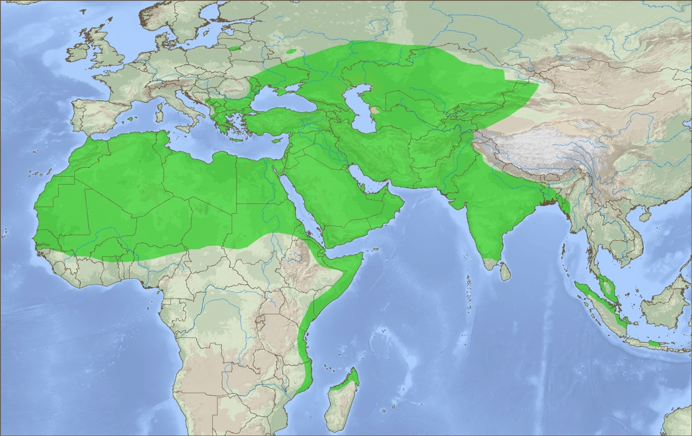
Muslim Movements to Christ 21st Century
First 12 years of the 21st century add 69 new Muslim movements to Christ!
The greatest turning of Muslims to Christ in history is occurring today.
19 new Muslim movements emerge in the rest of Asia
35 new movements emerge in Africa
15 new movements in the Middle East and W. Asia
Muslim Movements to Christ
Precise locations altered for security purposes
© 2013 WIGTake Resources
www.WindintheHouse.org
Notes:
The first thirteen years of the 21st century have seen more Muslim movements to Christ than at any time in history. Due to the sensitivity of these movements, their precise locations have been obscured to protect those involved; it is still a capital offense for Muslims to convert from Islam.
Fifteen new Muslim movements to Christ have erupted in the Middle East and Western Asia. Nineteen additional movements are taking place in Eastern and Southeastern Asia. Meanwhile, in East, North and West Africa a further 35 movements of Muslims to Christ have reached or exceeded the threshold of 1,000 baptism or 100 new church starts.
Something is happening, something historic. A Wind is blowing through the House of Islam.

Slide 10
Ten Lessons Learned
Diversity (多樣性) in the Muslim world.
© 2013 WIGTake Resources
www.WindintheHouse.org
Notes:
A Wind in the House of Islam is the result of more than a thousand interviews from Muslim-background believers, each one a part of the movements that are taking place from West Africa to Indo-Malaysia. Listening to these stories have allowed us to identify bridges that God is using to draw Muslims to Christ throughout the House of Islam.
Here are 10 bridges that God is using to foster movements of Muslims to Christ today:
1. Faith – believing that God desires Muslims’ salvation, and acting on that belief.
2. Prayer – the invisible force that tears down strongholds and unleashes the power of God.
3. Scripture – only as the word of God is translated into the heart languages of Muslims are they able to hear and respond to the gospel. Much remains to be done!
4. Holy Spirit – dreams, visions, conviction of lostness, answered prayers. Could it be that the Spirit has been at work for centuries, but we’re just now around to hear about it?
5. Faithful witness – Missionaries, historic Christian communities, giants who preceded us have been attested to in many testimonies of today’s Muslim-background movements.
6. Learning from the Body of Christ – as breakthroughs take place, effective patterns of witness are being shared. Many movements today trace to lessons first learned by others.
7. Effective communication – contextualized gospel witness is allowing Muslims to hear and understand the gospel’s message and its implications for them.
8. Discovery – As Muslims discover for themselves who Jesus is, they are drawn to Him.
9. Islam itself – Islam contains the seeds of its own destruction.
10. Indigenization – These movements are not foreign controlled. They are intensely owned by the Muslim-background believers who continue to pay a price for their faith in Christ.

Slide 11
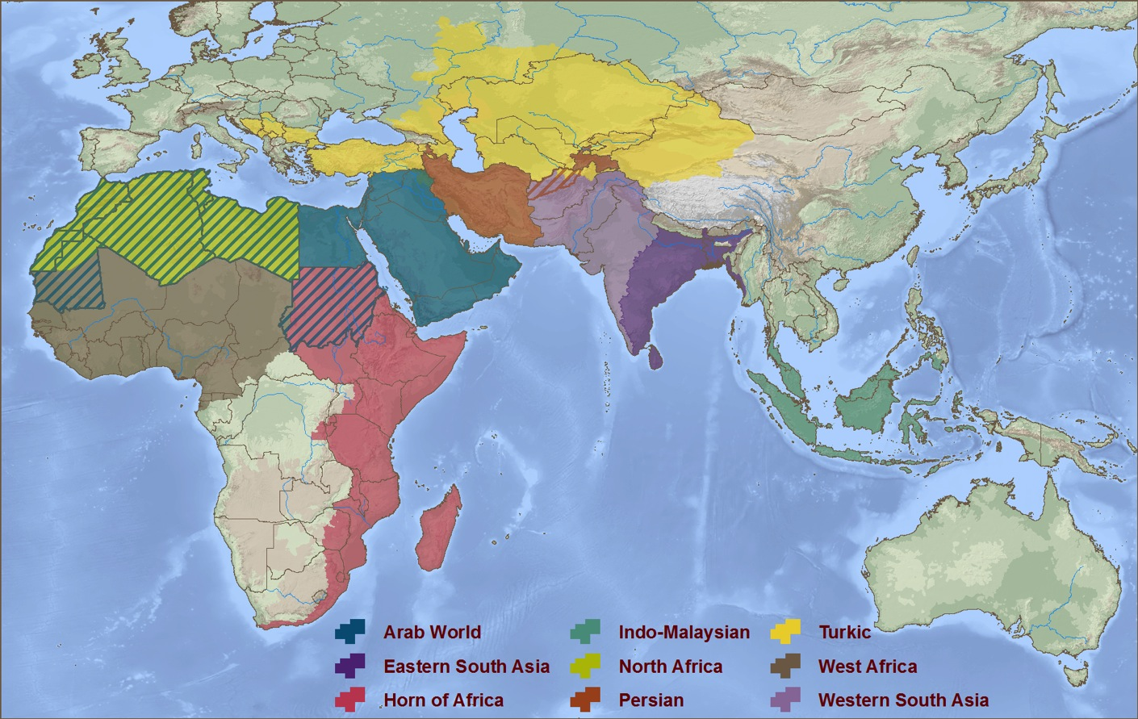
Nine Rooms in the House of Islam
Nine Distinct Cultural Zones
Turkestan
Persian
World
Western
South Asia
North Africa
Arab World
Eastern
South Asia
West Africa
East Africa
Indo-Malaysia
© 2013 WIGTake Resources
www.WindintheHouse.org
Notes:
To grasp the scope and nature of God’s work in the Muslim world today, we need to see the Muslim world more clearly.
The Muslim world, or House of Islam (Dar al-Islam, in Arabic), is no monolith. It comprises 1.6 billion adherents who can better be understood within nine distinct geo-cultural zones, or “Rooms in the House of Islam.”
These Rooms, from West to East, are (1) West Africa, (2) North Africa, (3) Eastern Africa (the Horn of Africa), (4) the Arab World, (5) the Persian World, (6) Turkestan, (7) Western South Asia, (8) Eastern South Asia, and (9) Indo-Malaysia.
These Rooms are defined by geography, history, linguistics and culture. The Wind of God’s Spirit is blowing through each one of them, and there is at least one movement in each Room. Some of them have multiple movements occurring within them.
Let’s take a closer look at each Room. We will enter each Room in the order in which the Muslim movements of the past two centuries have taken place giving attention to the nature of each Room and the unfinished Great Commission task ahead.

Slide 12
Ten Lessons Learned
Jesus is more winsome (有吸引力的) than Christianity.
© 2013 WIGTake Resources
www.WindintheHouse.org
Notes:
A Wind in the House of Islam is the result of more than a thousand interviews from Muslim-background believers, each one a part of the movements that are taking place from West Africa to Indo-Malaysia. Listening to these stories have allowed us to identify bridges that God is using to draw Muslims to Christ throughout the House of Islam.
Here are 10 bridges that God is using to foster movements of Muslims to Christ today:
1. Faith – believing that God desires Muslims’ salvation, and acting on that belief.
2. Prayer – the invisible force that tears down strongholds and unleashes the power of God.
3. Scripture – only as the word of God is translated into the heart languages of Muslims are they able to hear and respond to the gospel. Much remains to be done!
4. Holy Spirit – dreams, visions, conviction of lostness, answered prayers. Could it be that the Spirit has been at work for centuries, but we’re just now around to hear about it?
5. Faithful witness – Missionaries, historic Christian communities, giants who preceded us have been attested to in many testimonies of today’s Muslim-background movements.
6. Learning from the Body of Christ – as breakthroughs take place, effective patterns of witness are being shared. Many movements today trace to lessons first learned by others.
7. Effective communication – contextualized gospel witness is allowing Muslims to hear and understand the gospel’s message and its implications for them.
8. Discovery – As Muslims discover for themselves who Jesus is, they are drawn to Him.
9. Islam itself – Islam contains the seeds of its own destruction.
10. Indigenization – These movements are not foreign controlled. They are intensely owned by the Muslim-background believers who continue to pay a price for their faith in Christ.

Slide 13
Ten Lessons Learned
Contextualization (本色化)vs. Indigenization (本土化).
© 2013 WIGTake Resources
www.WindintheHouse.org
Notes:
A Wind in the House of Islam is the result of more than a thousand interviews from Muslim-background believers, each one a part of the movements that are taking place from West Africa to Indo-Malaysia. Listening to these stories have allowed us to identify bridges that God is using to draw Muslims to Christ throughout the House of Islam.
Here are 10 bridges that God is using to foster movements of Muslims to Christ today:
1. Faith – believing that God desires Muslims’ salvation, and acting on that belief.
2. Prayer – the invisible force that tears down strongholds and unleashes the power of God.
3. Scripture – only as the word of God is translated into the heart languages of Muslims are they able to hear and respond to the gospel. Much remains to be done!
4. Holy Spirit – dreams, visions, conviction of lostness, answered prayers. Could it be that the Spirit has been at work for centuries, but we’re just now around to hear about it?
5. Faithful witness – Missionaries, historic Christian communities, giants who preceded us have been attested to in many testimonies of today’s Muslim-background movements.
6. Learning from the Body of Christ – as breakthroughs take place, effective patterns of witness are being shared. Many movements today trace to lessons first learned by others.
7. Effective communication – contextualized gospel witness is allowing Muslims to hear and understand the gospel’s message and its implications for them.
8. Discovery – As Muslims discover for themselves who Jesus is, they are drawn to Him.
9. Islam itself – Islam contains the seeds of its own destruction.
10. Indigenization – These movements are not foreign controlled. They are intensely owned by the Muslim-background believers who continue to pay a price for their faith in Christ.

Slide 14
Ten Lessons Learned
Muslims are not the same as Islam.
© 2013 WIGTake Resources
www.WindintheHouse.org
Notes:
A Wind in the House of Islam is the result of more than a thousand interviews from Muslim-background believers, each one a part of the movements that are taking place from West Africa to Indo-Malaysia. Listening to these stories have allowed us to identify bridges that God is using to draw Muslims to Christ throughout the House of Islam.
Here are 10 bridges that God is using to foster movements of Muslims to Christ today:
1. Faith – believing that God desires Muslims’ salvation, and acting on that belief.
2. Prayer – the invisible force that tears down strongholds and unleashes the power of God.
3. Scripture – only as the word of God is translated into the heart languages of Muslims are they able to hear and respond to the gospel. Much remains to be done!
4. Holy Spirit – dreams, visions, conviction of lostness, answered prayers. Could it be that the Spirit has been at work for centuries, but we’re just now around to hear about it?
5. Faithful witness – Missionaries, historic Christian communities, giants who preceded us have been attested to in many testimonies of today’s Muslim-background movements.
6. Learning from the Body of Christ – as breakthroughs take place, effective patterns of witness are being shared. Many movements today trace to lessons first learned by others.
7. Effective communication – contextualized gospel witness is allowing Muslims to hear and understand the gospel’s message and its implications for them.
8. Discovery – As Muslims discover for themselves who Jesus is, they are drawn to Him.
9. Islam itself – Islam contains the seeds of its own destruction.
10. Indigenization – These movements are not foreign controlled. They are intensely owned by the Muslim-background believers who continue to pay a price for their faith in Christ.

Slide 15
Ten Lessons Learned
Islam is much more than text and doctrines (教義).
© 2013 WIGTake Resources
www.WindintheHouse.org
Notes:
A Wind in the House of Islam is the result of more than a thousand interviews from Muslim-background believers, each one a part of the movements that are taking place from West Africa to Indo-Malaysia. Listening to these stories have allowed us to identify bridges that God is using to draw Muslims to Christ throughout the House of Islam.
Here are 10 bridges that God is using to foster movements of Muslims to Christ today:
1. Faith – believing that God desires Muslims’ salvation, and acting on that belief.
2. Prayer – the invisible force that tears down strongholds and unleashes the power of God.
3. Scripture – only as the word of God is translated into the heart languages of Muslims are they able to hear and respond to the gospel. Much remains to be done!
4. Holy Spirit – dreams, visions, conviction of lostness, answered prayers. Could it be that the Spirit has been at work for centuries, but we’re just now around to hear about it?
5. Faithful witness – Missionaries, historic Christian communities, giants who preceded us have been attested to in many testimonies of today’s Muslim-background movements.
6. Learning from the Body of Christ – as breakthroughs take place, effective patterns of witness are being shared. Many movements today trace to lessons first learned by others.
7. Effective communication – contextualized gospel witness is allowing Muslims to hear and understand the gospel’s message and its implications for them.
8. Discovery – As Muslims discover for themselves who Jesus is, they are drawn to Him.
9. Islam itself – Islam contains the seeds of its own destruction.
10. Indigenization – These movements are not foreign controlled. They are intensely owned by the Muslim-background believers who continue to pay a price for their faith in Christ.

Slide 16
Ten Lessons Learned
Gospel Non-Negotiables (不能妥協的).
© 2013 WIGTake Resources
www.WindintheHouse.org
Notes:
A Wind in the House of Islam is the result of more than a thousand interviews from Muslim-background believers, each one a part of the movements that are taking place from West Africa to Indo-Malaysia. Listening to these stories have allowed us to identify bridges that God is using to draw Muslims to Christ throughout the House of Islam.
Here are 10 bridges that God is using to foster movements of Muslims to Christ today:
1. Faith – believing that God desires Muslims’ salvation, and acting on that belief.
2. Prayer – the invisible force that tears down strongholds and unleashes the power of God.
3. Scripture – only as the word of God is translated into the heart languages of Muslims are they able to hear and respond to the gospel. Much remains to be done!
4. Holy Spirit – dreams, visions, conviction of lostness, answered prayers. Could it be that the Spirit has been at work for centuries, but we’re just now around to hear about it?
5. Faithful witness – Missionaries, historic Christian communities, giants who preceded us have been attested to in many testimonies of today’s Muslim-background movements.
6. Learning from the Body of Christ – as breakthroughs take place, effective patterns of witness are being shared. Many movements today trace to lessons first learned by others.
7. Effective communication – contextualized gospel witness is allowing Muslims to hear and understand the gospel’s message and its implications for them.
8. Discovery – As Muslims discover for themselves who Jesus is, they are drawn to Him.
9. Islam itself – Islam contains the seeds of its own destruction.
10. Indigenization – These movements are not foreign controlled. They are intensely owned by the Muslim-background believers who continue to pay a price for their faith in Christ.

Slide 17
Ten Lessons Learned
Muslim converts are in process.
© 2013 WIGTake Resources
www.WindintheHouse.org
Notes:
A Wind in the House of Islam is the result of more than a thousand interviews from Muslim-background believers, each one a part of the movements that are taking place from West Africa to Indo-Malaysia. Listening to these stories have allowed us to identify bridges that God is using to draw Muslims to Christ throughout the House of Islam.
Here are 10 bridges that God is using to foster movements of Muslims to Christ today:
1. Faith – believing that God desires Muslims’ salvation, and acting on that belief.
2. Prayer – the invisible force that tears down strongholds and unleashes the power of God.
3. Scripture – only as the word of God is translated into the heart languages of Muslims are they able to hear and respond to the gospel. Much remains to be done!
4. Holy Spirit – dreams, visions, conviction of lostness, answered prayers. Could it be that the Spirit has been at work for centuries, but we’re just now around to hear about it?
5. Faithful witness – Missionaries, historic Christian communities, giants who preceded us have been attested to in many testimonies of today’s Muslim-background movements.
6. Learning from the Body of Christ – as breakthroughs take place, effective patterns of witness are being shared. Many movements today trace to lessons first learned by others.
7. Effective communication – contextualized gospel witness is allowing Muslims to hear and understand the gospel’s message and its implications for them.
8. Discovery – As Muslims discover for themselves who Jesus is, they are drawn to Him.
9. Islam itself – Islam contains the seeds of its own destruction.
10. Indigenization – These movements are not foreign controlled. They are intensely owned by the Muslim-background believers who continue to pay a price for their faith in Christ.

Slide 18
Ten Lessons Learned
We have important roles to play.
© 2013 WIGTake Resources
www.WindintheHouse.org
Notes:
A Wind in the House of Islam is the result of more than a thousand interviews from Muslim-background believers, each one a part of the movements that are taking place from West Africa to Indo-Malaysia. Listening to these stories have allowed us to identify bridges that God is using to draw Muslims to Christ throughout the House of Islam.
Here are 10 bridges that God is using to foster movements of Muslims to Christ today:
1. Faith – believing that God desires Muslims’ salvation, and acting on that belief.
2. Prayer – the invisible force that tears down strongholds and unleashes the power of God.
3. Scripture – only as the word of God is translated into the heart languages of Muslims are they able to hear and respond to the gospel. Much remains to be done!
4. Holy Spirit – dreams, visions, conviction of lostness, answered prayers. Could it be that the Spirit has been at work for centuries, but we’re just now around to hear about it?
5. Faithful witness – Missionaries, historic Christian communities, giants who preceded us have been attested to in many testimonies of today’s Muslim-background movements.
6. Learning from the Body of Christ – as breakthroughs take place, effective patterns of witness are being shared. Many movements today trace to lessons first learned by others.
7. Effective communication – contextualized gospel witness is allowing Muslims to hear and understand the gospel’s message and its implications for them.
8. Discovery – As Muslims discover for themselves who Jesus is, they are drawn to Him.
9. Islam itself – Islam contains the seeds of its own destruction.
10. Indigenization – These movements are not foreign controlled. They are intensely owned by the Muslim-background believers who continue to pay a price for their faith in Christ.

Slide 19
Best Practices
1. Ten Bridges from A Wind in the House
2. Five Barriers from A Wind in the House
3. The Value of Apologetics (護教學)
4. The Camel Method
5. Discovery Bible Studies
6. T4T: Training for Trainers
7. Any-3: Anyone, Anywhere, Any Time
© 2013 WIGTake Resources
www.WindintheHouse.org
Notes:
These best practice resources are available on the website: www.ChurchPlantingMovements.com/bookstore

Slide 20
Ten Lessons Learned
The power is in the gospel.
© 2013 WIGTake Resources
www.WindintheHouse.org
Notes:
A Wind in the House of Islam is the result of more than a thousand interviews from Muslim-background believers, each one a part of the movements that are taking place from West Africa to Indo-Malaysia. Listening to these stories have allowed us to identify bridges that God is using to draw Muslims to Christ throughout the House of Islam.
Here are 10 bridges that God is using to foster movements of Muslims to Christ today:
1. Faith – believing that God desires Muslims’ salvation, and acting on that belief.
2. Prayer – the invisible force that tears down strongholds and unleashes the power of God.
3. Scripture – only as the word of God is translated into the heart languages of Muslims are they able to hear and respond to the gospel. Much remains to be done!
4. Holy Spirit – dreams, visions, conviction of lostness, answered prayers. Could it be that the Spirit has been at work for centuries, but we’re just now around to hear about it?
5. Faithful witness – Missionaries, historic Christian communities, giants who preceded us have been attested to in many testimonies of today’s Muslim-background movements.
6. Learning from the Body of Christ – as breakthroughs take place, effective patterns of witness are being shared. Many movements today trace to lessons first learned by others.
7. Effective communication – contextualized gospel witness is allowing Muslims to hear and understand the gospel’s message and its implications for them.
8. Discovery – As Muslims discover for themselves who Jesus is, they are drawn to Him.
9. Islam itself – Islam contains the seeds of its own destruction.
10. Indigenization – These movements are not foreign controlled. They are intensely owned by the Muslim-background believers who continue to pay a price for their faith in Christ.

Slide 21
Learn more…
© 2013 WIGTake Resources
www.WindintheHouse.org
Notes:
Don’t satisfy yourself to be a spectator in the greatest turning of Muslims to Christ in history. Sadly, most Christians only see Muslims as a threat, as the enemy of God’s Kingdom. They don’t realize that God loves Muslims too, and wants to see their salvation.
Learn more about God’s amazing work in the Muslim world, read about the stories of thousands of Muslims who are saying yes to Christ and finding forgiveness, salvation and new life in Him. Spread the word: there is a Wind blowing through the House of Islam!

