Slide 1
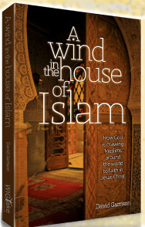
Panorama of
Muslim Movements to Christ
縱覽穆斯林歸主運動
From the new book by David Garrison.
© 2013 WIGTake Resources
www.WindintheHouse.org
Notes:
The contents of this PowerPoint presentation are adapted from the book by Dr. David Garrison, A Wind in the House of Islam (Monument, CO: WIGTake Resources, 2014), 328 pp. ©WIGTake Resources. The book is available for purchase from the website: www.WindintheHouse.org.
This PowerPoint is a gift to the community of Christ and may be used freely so long as attribution is given to the book A Wind in the House of Islam.
Requests for modification of the PowerPoint should be directed to: Nora Hutchins of WIGTake Resources at NoHutch@wigtake.org.
This PowerPoint along with the notes is produced by David Garrison. Maps are produced by Jim Courson of the Global Research Department of the International Mission Board, SBC.

Slide 2
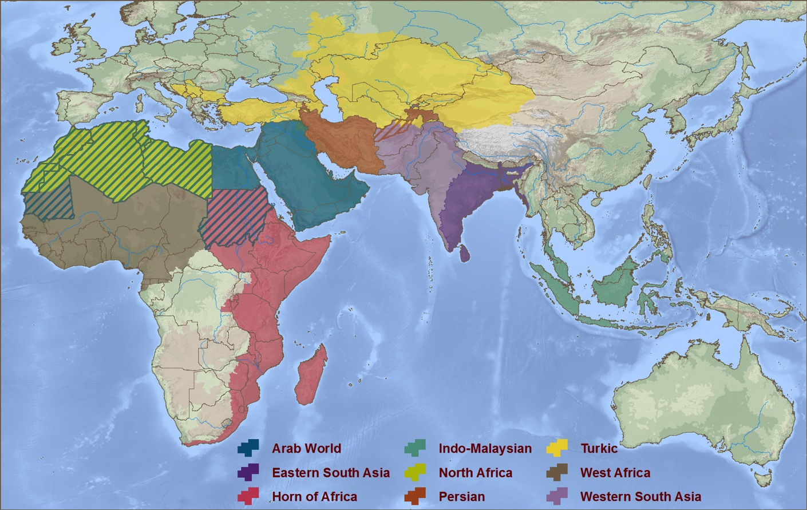
Nine Rooms in the House of Islam
Turkestan
Persian
World
Western
South Asia
North Africa
Arab World
Eastern
South Asia
West Africa
East Africa
Indo-Malaysia
© 2013 WIGTake Resources
www.WindintheHouse.org
Notes:
The House of Islam, or Dar al-Islam in Arabic, can be divided into nine geo-cultural zones or “Rooms” in the House of Islam. There are Muslim movements to Christ in each of the Nine Rooms.

Slide 3
Fourteen Centuries of Islamic Expansion
Tens of millions of Christians assimilated(被同化) into Islam
© 2013 WIGTake Resources
www.WindintheHouse.org
Notes:
Looking back, the growth of Islam, from a tiny desert community in Mecca in the 7th century to the second largest religion in the world today, has been remarkable. Over the course of these nearly 14 centuries, Islam has gained adherents in every continent and nearly every country on earth. Along the way, tens of millions of people groups with ancient Christian roots have been assimilated into the House of Islam.

Slide 4
But What About the Opposite?
Have there ever been Muslim movements to Christ?
If so, where, when and how?
© 2013 WIGTake Resources
www.WindintheHouse.org
Notes:
Surely in the course of these nearly 14 centuries there have also been movements in the other direction. We know that individual men, women, and children have converted from Islam to Christianity, but have these ever occurred in significant numbers?
If we define a movement of Muslims to Christ as 1,000 baptisms or 100 new church starts over the course of one to two decades, can we find historic examples of Muslim movements to Christ? If so, where, when, and how did they occur?
Let’s review Muslim-Christian history now with an eye for Muslim movements to Christ.

Slide 5
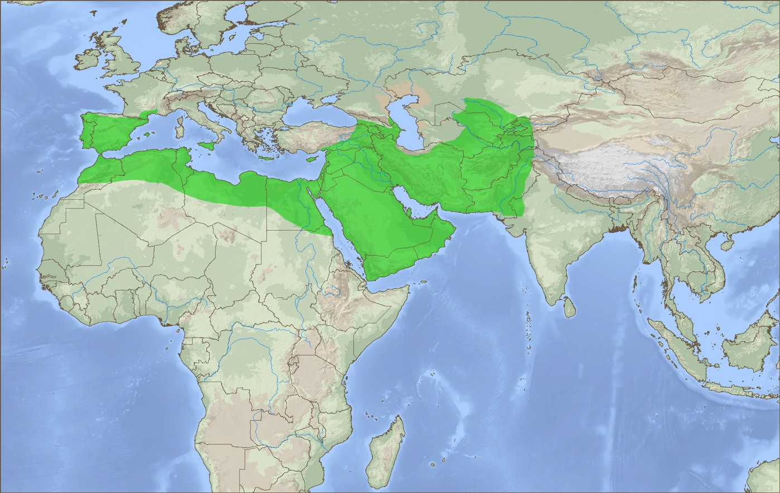
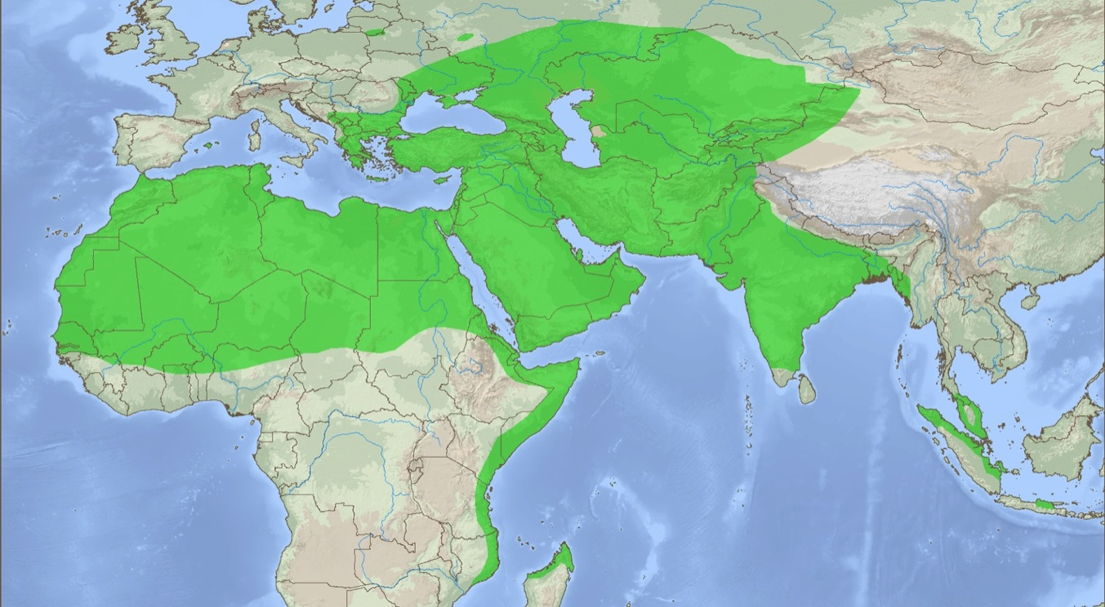
Muslim Movements to Christ 7th - 10th Century
The first 350 years, only one dubious Muslim movement to Christ
In 982
12,000 Arab Muslims
Muslim Movements to Christ
Muslim Movements to Christ
© 2013 WIGTake Resources
www.WindintheHouse.org
Notes:
During the first three and a half centuries of Islam’s existence, Muslims were in frequent, daily contact with Christians. Despite considerable Christian interaction, and noteworthy Christian apologetics, there were virtually no movements of Muslim communities into the Christian religion during these first three and a half centuries. Much of the interaction between the two religions was characterized by violent clashes and military campaigns between Christian and Muslim armies.
During the late 10th century, as the Abbasid Empire was unraveling, lesser rulers in the Near East vied for influence. In the year 975, the Byzantine Emperor John Tzimiskes (925-976) extended Byzantine sway into Muslim territory in what is today eastern Turkey, Syria and northern Lebanon. In the turbulent years that followed, historians reported that and Arab tribe of 12,000 men (and presumably their families as well) from the vicinity of Nisibis, on today’s Syria-Turkey border, sought and received baptism. Their reported motivation was relief from high taxation under the Muslim Abbasids.
Within a century, though, Muslim armies had restored control over this territory and much more. Eventually, all of those converts were re-absorbed into the House of Islam.

Slide 6
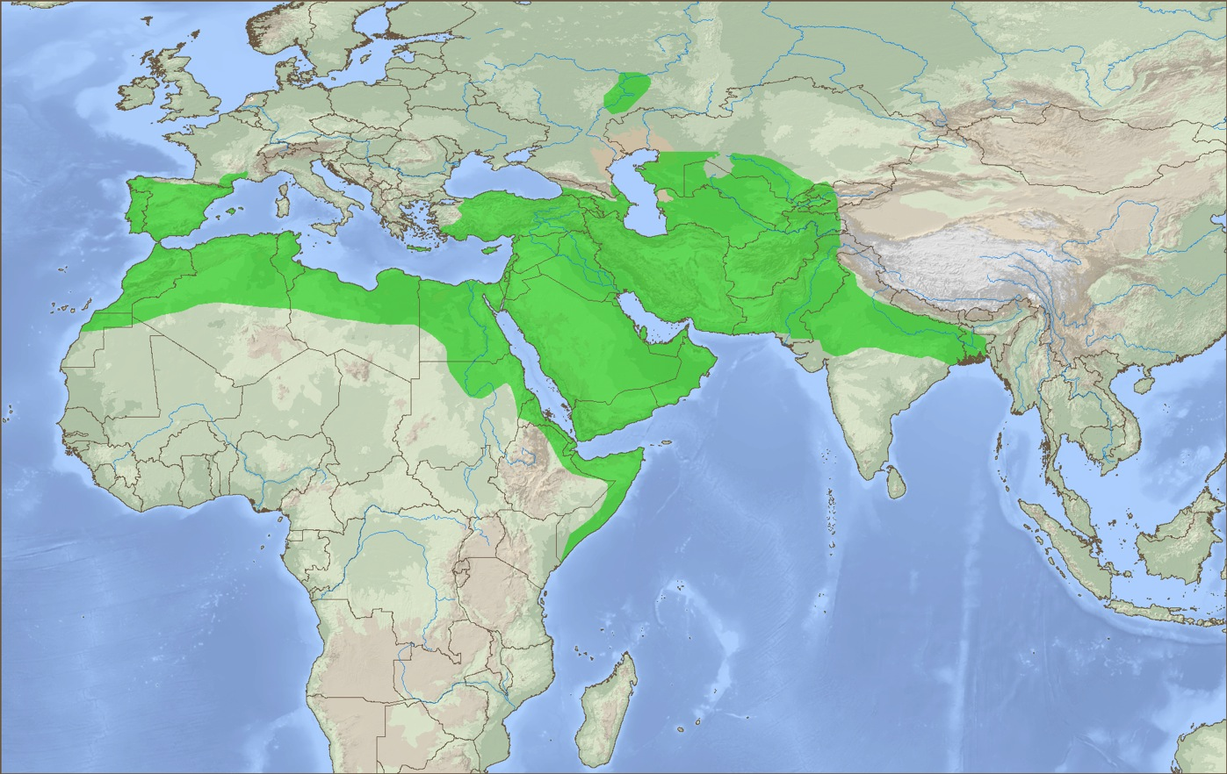
Muslim Movements to Christ 11th - 13th Century
Crusades, Inquisitions and Other Failures
1095-1292 Nine Crusades.(十字軍東征)
13th century Inquisition
(宗教裁判所)
1250-73 William of Tripoli
Conrad of Ascoli
St. Dominic
St. Francis of Assisi
and Ramon Llull
Muslim Movements to Christ
© 2013 WIGTake Resources
www.WindintheHouse.org
Notes:
The 11th – 13th centuries saw European Christian armies launch nine Crusades into the Muslim-held Holy Land. Brief victories came at the expense of tens of thousands of Muslim lives. By the end of the thirteenth century, all Christian military gains in the Holy Land were lost.
The 12th and 13th centuries also witnessed innovative outreach to Muslims. The first came under the rule of Roger II of Sicily (1095-1154). Roger’s Norman kingdom welcomed religious and cultural interchange; the resulting pluralistic society produced unknown numbers of Muslim converts to the gospel. Roger’s experiment in multi-culturalism ended when his grandson, William II, expelled Muslims from the realm as he joined the Third Crusade.
In the 13th century, Italian Catholics Saints Dominic (1170-1221) and Francis (1181-1226) founded the Dominican and Franciscan Orders with a vision to take the gospel to the Muslim world. Neither man saw any movements of Muslims to Christ, but their counter-cultural impulse presented a gospel alternative to the Christian military Crusades.
Dominican General Raymond of Peñafort (fl. 1260) mobilized outreach to Muslims in Spain, and saw many thousands of baptisms, but under threat of the Spanish Inquisition. Dominican Friar William of Tripoli (fl. 1250-1274) reportedly baptized some 1,000 Muslims in the Levant, but these appear to have been lost along with the Crusades soon after the fall of Acre 1291.
Italian Franciscan Conrad of Ascoli (c. 1275) preached the gospel in Libya, and reportedly saw 6,400 Libyans baptized. Whether these converts were Muslims or African slaves is unknown.
Ramon Llull (1232-1315), a Catalonian mystic, mastered Arabic and philosophy then took three largely unfruitful missionary trips to North Africa (in what is today Tunisia and Algeria).

Slide 7
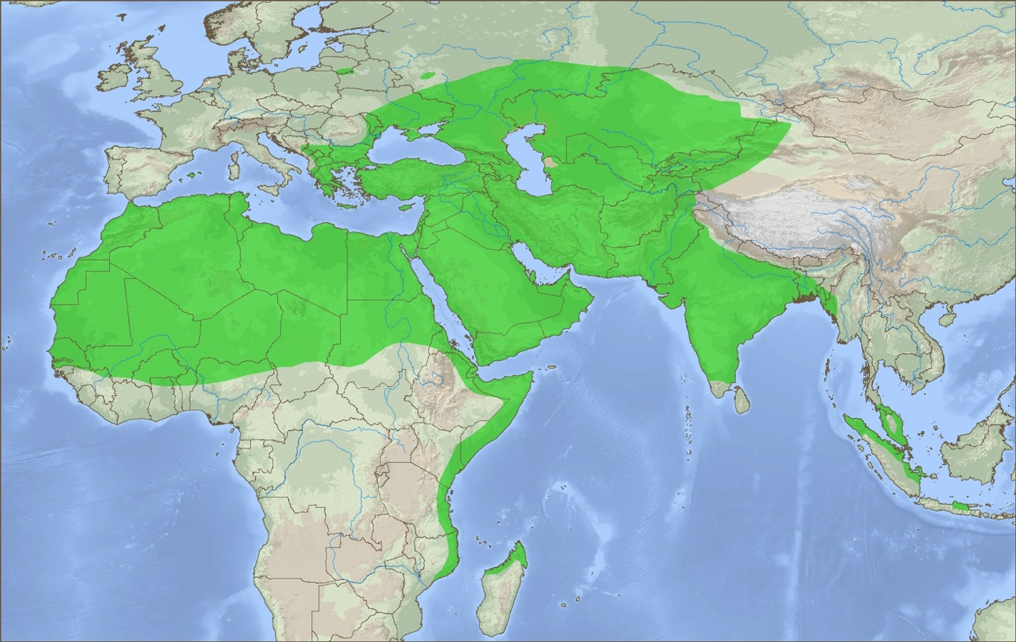
Muslim Movements to Christ 14th-18th Century
Another 500 years without a Muslim movement to Christ
No voluntary Muslim movements to Christ.
Muslim Movements to Christ
© 2013 WIGTake Resources
www.WindintheHouse.org
Notes:
The 14th – 18th centuries saw European, mostly Spanish, Portuguese and Dutch, expansion around the world, but with minimal direct impact on the Muslim world. During this period, Spain and Portugal completed their expulsion or forced conversion of Muslims in Iberia.
Otherwise, these five hundred years saw no movements of Muslims into the Christian religion, while millions of ancient Christian populations in the Middle East, North Africa and Central Asia were being assimilated into the House of Islam.

Slide 8


Muslim Movements to Christ 19th Century
The “Great Century” in the Expansion of Christianity
The “Great Century”
two movements
1870-1930 Catholic “White Fathers” in Algeria
Sadrach of Java (1835-1924) 10-20,000 Muslim converts
1890-1920 Shaik Zakaryas of Ethiopia
Muslim Movements to Christ
© 2013 WIGTake Resources
www.WindintheHouse.org
Notes:
Yale mission historian Kenneth Scott Latourette called the 19th century the Great Century in the expansion of Christianity as Protestant missionaries took the gospel into Asia, Africa and the Americas. Despite this great expansion, few Muslims responded to gospel outreach.
Three notable exceptions took place in Indonesia, Ethiopia and French Algeria. In 1870, Indonesian Sadrach of Java initiated what may have been the first voluntary movement of Muslims to Christ in history, nearly twelve and a half centuries after the founding of the Islamic religion . By the time of his death in 1924, Sadrach’s Kristen Jawa (Javanese Christians), numbered 10-20,000.
In northern Ethiopia a Muslim sheikh by the name of Zakaryas had a dream about Isa (Jesus) that compelled him to obtain a New Testament from a Swedish missionary bookstore. By the time of his death in 1920, Shaykh (sic) Zakaryas had led some 7,000 Ethiopian Muslims to baptism and faith in Jesus Christ.
Pioneering missionary work in Algeria by the French Catholic Pere Blanc (White Fathers) resulted in the baptism of some 700 Algerian Kabyle Berbers. Though the numbers did not constitute a movement, by our definition, they did represent a significant breakthrough. Something was happening.

Slide 9
Muslim Movements to Christ 20th Century
The 20th century adds 11 new Muslim movements to Christ
Albania - several thousand Muslim conversions.
1989 Iron Curtain falls
thousands of Muslims come to Christ.
1980s-90s, Bangladesh Movts.
1990s Algerian Civil War 10-30,000 Berbers turn to Christ.
Post-1979 Iran.
1967-1971 two million Muslims convert
Muslim Movements to Christ
© 2013 WIGTake Resources
www.WindintheHouse.org
Notes:
The 20th century saw the greatest turning of Muslims to Christ in the 13-century history of Muslim-Christian interaction to date. All of these movements occurred in the latter half of the century.
The first movement, and the largest, did not occur until 1967-1971, when 2.8 million Indonesians, most of whom were Muslims, were baptized into Christian churches. The great catalyst for this movement was the government purges that followed an aborted Communist coupe in 1965.
The 1979 Islamic Revolution in Iran prompted hundreds of thousands of Iranian Shi’ite Muslims to convert to Christianity over the next four decades. Innovative outreach to Muslims in Bangladesh in the 1980s and 90s led to thousands of Bengali conversions that continue to the present. The bloody 1990s civil war in Algeria contributed to more than 10,000 Kabyle conversions to Christianity. The fall of the Iron Curtain in 1989 opened the way for thousands of Soviet Central Asian Muslims hearing and responding to the gospel in the decades that followed. Collateral movements occurred in post-Communist Albania.
Responding to Christian ministry and witness in the famine-stricken Sahel, more than a thousand Muslims came to Christ in West Africa.
The pace and number of Muslim movements to Christ was on the rise, setting the stage for the explosive growth that would occur in the century that followed.

Slide 10
Muslim Movements to Christ through the Centuries
Notes:
A retrospective look at nearly 14 centuries of Muslim-Christian interaction tells the story. Over these same centuries, tens of millions of Christians were converted to Islam and assimilated into the House of Islam. Yet in the first millennium of Muslim-Christian interchange, we could find only three possible movements of at least 1,000 Muslims from an Islamic community being baptized into any expression of the Christian faith.
The first hint of a shift in direction occurs in the latter decades of the 19th century, followed by a further 11 movements in the final third of the 20th century. However, in just the first 13 years of the 21st century, we have already seen an additional 69 Muslim movements to Christ.
We are indeed living in the midst of the greatest turning of Muslims to Christ in history.

Slide 11
Muslim Movements to Christ 21st Century
First 12 years of the 21st century add 69 new Muslim movements to Christ!
The greatest turning of Muslims to Christ in history is occurring today.
19 new Muslim movements emerge in the rest of Asia
35 new movements emerge in Africa
15 new movements in the Middle East and W. Asia
Muslim Movements to Christ
Precise locations altered for security purposes
© 2013 WIGTake Resources
www.WindintheHouse.org
Notes:
The first thirteen years of the 21st century have seen more Muslim movements to Christ than at any time in history. Due to the sensitivity of these movements, their precise locations have been obscured to protect those involved; it is still a capital offense for Muslims to convert from Islam.
Fifteen new Muslim movements to Christ have erupted in the Middle East and Western Asia. Nineteen additional movements are taking place in Eastern and Southeastern Asia. Meanwhile, in East, North and West Africa a further 35 movements of Muslims to Christ have reached or exceeded the threshold of 1,000 baptism or 100 new church starts.
Something is happening, something historic. A Wind is blowing through the House of Islam.

Slide 12
Something is happening
Look to the nations, watch–and be utterly amazed. For I am going to do something in your days that you would not believe, even if you were told.
你們要向列國觀看，注意看，要驚奇，再驚奇！因為在你們的日子，有一件事發生，儘管有人說了，你們還是不信。
Habakkuk哈巴谷書 1:5
© 2013 WIGTake Resources
www.WindintheHouse.org
Notes:
More than two and a half thousand years ago, speaking through the prophet Habakkuk, God instructed His people to look to the nations, literally the goy, or people groups, of the world, among whom He said he would do something amazing, so amazing, in fact, that they would not believe it, even if they were told.
Many of God’s people see this prophecy as occurring today. God is doing something amazing among the nations of the earth, something that challenges our ability to grasp.

Slide 13
How is God at Work?
Lessons from 1000+
Movement Interviews 訪問
© 2013 WIGTake Resources
www.WindintheHouse.org
Notes:
Looking back, the growth of Islam, from a tiny desert community in Mecca in the 7th century to the second largest religion in the world today, has been remarkable. Over the course of these nearly 14 centuries, Islam has gained adherents in every continent and nearly every country on earth. Along the way, tens of millions of people groups with ancient Christian roots have been assimilated into the House of Islam.

Slide 14
Desired Outcomes
Learn how God is at work today.
Inform Muslims that today is their day of salvation.
Inform Christians that God desires the salvation of Muslims today.
Align(校準) ourselves with the ways God is at work.
© 2013 WIGTake Resources
www.WindintheHouse.org
Notes:
A Wind in the House of Islam is the result of more than a thousand interviews from Muslim-background believers, each one a part of the movements that are taking place from West Africa to Indo-Malaysia. Listening to these stories have allowed us to identify bridges that God is using to draw Muslims to Christ throughout the House of Islam.
Here are 10 bridges that God is using to foster movements of Muslims to Christ today:
1. Faith – believing that God desires Muslims’ salvation, and acting on that belief.
2. Prayer – the invisible force that tears down strongholds and unleashes the power of God.
3. Scripture – only as the word of God is translated into the heart languages of Muslims are they able to hear and respond to the gospel. Much remains to be done!
4. Holy Spirit – dreams, visions, conviction of lostness, answered prayers. Could it be that the Spirit has been at work for centuries, but we’re just now around to hear about it?
5. Faithful witness – Missionaries, historic Christian communities, giants who preceded us have been attested to in many testimonies of today’s Muslim-background movements.
6. Learning from the Body of Christ – as breakthroughs take place, effective patterns of witness are being shared. Many movements today trace to lessons first learned by others.
7. Effective communication – contextualized gospel witness is allowing Muslims to hear and understand the gospel’s message and its implications for them.
8. Discovery – As Muslims discover for themselves who Jesus is, they are drawn to Him.
9. Islam itself – Islam contains the seeds of its own destruction.
10. Indigenization – These movements are not foreign controlled. They are intensely owned by the Muslim-background believers who continue to pay a price for their faith in Christ.

Slide 15
Learn more…
© 2013 WIGTake Resources
www.WindintheHouse.org
Notes:
Don’t satisfy yourself to be a spectator in the greatest turning of Muslims to Christ in history. Sadly, most Christians only see Muslims as a threat, as the enemy of God’s Kingdom. They don’t realize that God loves Muslims too, and wants to see their salvation.
Learn more about God’s amazing work in the Muslim world, read about the stories of thousands of Muslims who are saying yes to Christ and finding forgiveness, salvation and new life in Him. Spread the word: there is a Wind blowing through the House of Islam!

